Slide 1


Slide 2



Employee Retention Prediction
“In the field of workforce analytics, this project focuses on predicting employee retention by applying machine learning–based predictive techniques. The study analyzes a combination of demographic characteristics, professional background, educational attributes, and organizational factors to understand patterns influencing employee continuity. By refining prediction algorithms, the project aims to uncover hidden trends that enable early identification of employees who may be at risk of leaving. These insights support proactive human resource strategies, contributing to improved talent management, reduced attrition, and enhanced organizational stability and performance”.
Presented By : Keerthana

Slide 3

Introduction
Data Gathering /Data Refinement
01
02
Reason/Issue causing Employees to leave the job are predicted using models to find essential solution.
Comprehensive Dataset Overview
Refinement and Data Preparation Steps
EXPLORATORY DATA ANALYSIS
Feature Extraction
03
04
Find patterns and identify trends
Gain valuable insight from the dataset
Divide Features into X and Y
Machine Learning
Methodology
06
Experimental results
05
Algorithms or Models Used
Compare each Evaluate Algorithm
Visuals of Compared models
Accuracy, confusion matrix of models
Final prediction
Conclusion
07
Final prediction using test data
08
Using final prediction give a solution for employees are at risk of leaving the Job
Suggestion for future

Slide 4

INTRODUCTION :
The dataset explores key factors influencing job change behaviour among data scientists, providing insights into employee satisfaction, growth opportunities, and workplace stability
It includes 13 critical features such as experience, training hours, company size, education level, and more, offering a detailed understanding of workforce dynamics
The Target variable indicates whether an individual is likely to change a job(1) or stay in the current company(0)
Understanding these factors can help organizations optimize retention statergies, improve workforce planning, and reduce hiring costs

Slide 5


Monitor and Update
STEP
Continuously monitor the model's performance in the real-world scenario
07
Model Evaluation
STEP
06
Assessing the performance of a machine learning model using metrics
Model Selection and
Model Training
STEP
Choosing a suitable machine learning algorithm and optimizing its parameters
05
Split Train And Test Data
WORK FLOW
WORK FLOW
STEP
04
Dividing the dataset into training and Validation sets to evaluate
PREPROCESSING
STEP
Preparing and cleaning data to enhance its quality and suitability
03
Exploratory Data Analysis
STEP
02
Analyzing and visualizing data patterns to understand its characteristics
Data Collection
STEP
Gathering and organizing data to train machine learning models.
01

Slide 6

Data Acquisition and Preparation:
Dataset Overview:
The dataset contains 19,158 rows and 14 columns, representing data scientist’s attributes related to job retention and turnover
Features(Columns):
Demographic Information: Gender, Education Level, Relevent experience
Performance Metrics: Training hours, Experience
Employment Details: Company Size, Company Type, Last New Job
Location Insights: City Development Index, City
Target Variable(Y):
0: Employee is not likely to change jobs
1:Employee likely to change jobs
Refinement Techniques:
Feature Engineering
Outlier Handling and Data Normalization
Removal of irrelevant or low impactfull features

Slide 7

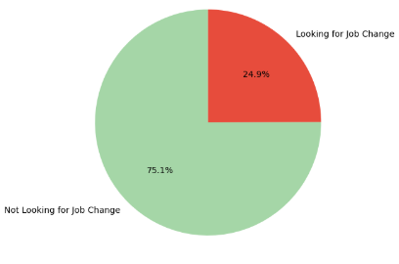
Exploratory Data Analysis
Exploratory Data Analysis (EDA) was conducted to examine the distribution of features, uncover patterns, and derive insights from both numerical and categorical variables
Analysis of the target variable showed a clear class imbalance, where approximately 75% of employees were not considering a job change, while 25% were open to switching jobs
A correlation matrix was applied to analyze relationships among numerical attributes, revealing notable associations such as a positive relationship between experience and last_new_job
Stacked bar plots and Density plots were utilized to explore interactions among important numerical variables, including experience, training_hours, and company_size and Categorical columns with target
Outliers present in numerical features, particularly training_hours, were detected and their influence on model performance was assessed during the data preprocessing stage
Both univariate and bivariate visualizations—such as histograms, heatmaps, and pie charts—were used to better understand feature distributions and their relationship with the target variable
Distribution of Target Variable
Looking for job change(1)
Not looking for Job Change(0)

Slide 8
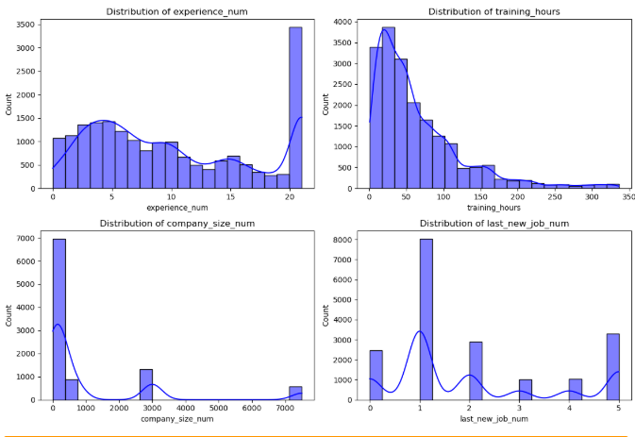
Continuous Variable Insights for Employee Retention Prediction Dataset
Experience:
Most employees have less than 10 years of work experience, indicating a workforce predominantly in the early to mid-stage of their careers
Training Hours:
A large proportion of employees completed fewer than 90 training hours, indicating that most employees receive basic to moderate levels of training
Company Size:
Most Employees are associated with small to mid-sized companies, with a higher concentration in smaller organizations
Last New Job:
A majority of employees switched jobs within 1-2 years, indicating relatively short job tenures
City Development Index:
The city Development index distribution is concentrated towards higher values, reflecting that most employees are located in well-developed urban areas with better infrastructure and economic conditions, which may influence retention patterns

Slide 9
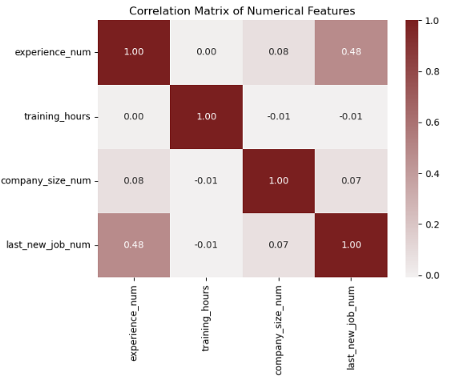
Correlation Insights for Employee Retention Prediction Dataset
Experience VS Last New Job – Correlation: 0.48
Moderate positive correlation
This shows more experienced employees tend to switch jobs less frequently
Experience VS Company Size – Correlation: 0.08
Weak positive correlation
Company size is almost independent of employees experience
Company size vs Last New Job – Correlation: 0.07
Weak correlation
Job-switching behavior is not strongly influenced by company size
Training Hours vs Experience – Correlation: 0.00
No correlation/Extremely weak
Experience level does not influence training hours
Training Hours vs Company size – Correlation: -0.01
Negligible negative correlation
Company size have no impact on training hours

Slide 10
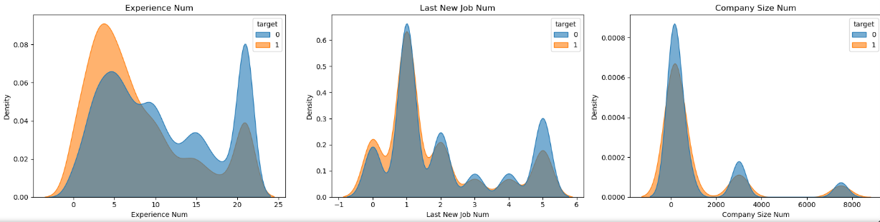
Continuous Features vs Target
The density plots comparing continuous features with the target variable indicate that employee retention (Target = 0) dominates across key ranges. For experience, higher experience levels show a stronger concentration of employees who stayed, while lower experience exhibits more overlap, suggesting experience has a meaningful influence on retention. In the last new job plot, the 0–1 year range clearly shows a higher density for Target = 0, indicating that employees who changed jobs recently are more likely to stay rather than leave. Similarly, in the company size plot, the 0–2000 company size range shows a stronger blue peak, confirming higher retention even in smaller organizations. Although overlap exists between classes in all three plots, the dominance of Target = 0 in these key ranges suggests these features have a moderate but informative influence on employee retention.

Slide 11
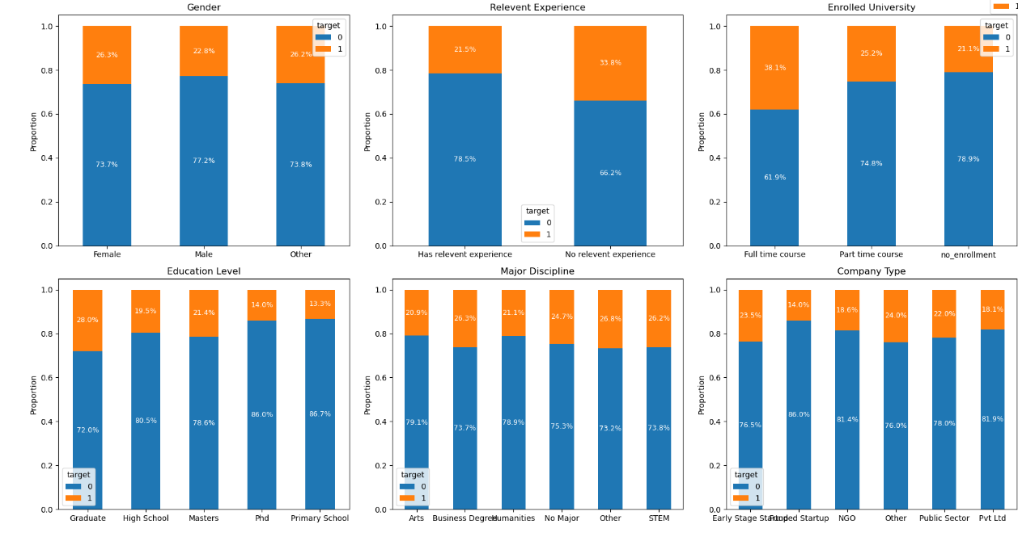
CATEGORICAL FEATURE vs TARGET
Gender:
Both male and female employees show higher retention (Target = 0) than attrition.
Retention is around 75–80%, attrition around 20–25%.Gender has minimal impact on employee retention.
Education Level:
All education levels show retention above 70%. Graduate and PhD categories show slightly higher retention.
Education level has a moderate influence, not a strong driver.
Major Discipline:
Retention remains consistently high (≈72–78%) across all disciplines. Differences between disciplines are small.
Major discipline alone does not strongly affect attrition.
Relevant Experience:
Employees with relevant experience show higher retention (~78–80%). Employees without relevant experience show slightly higher attrition.
Relevant experience has a noticeable influence.
Enrolled University:
Retention dominates across full-time, part-time, and not-enrolled categories.
Retention stays around 73–80%. Enrollment status has limited influence.
Company Type:
All company types show higher retention than attrition. Retention ranges around 72–85%.
Company type shows weak standalone impact.

Slide 12

Preprocessing
1.Handling Missing Values:
All the categorical columns (gender, enrolled_university, education level, major discipline, company type) were filled using the mode (most frequently repeated value)
2.Removing irrelavent columns: like enrollee_id
3.Encoding Categorical columns Using label encoder
4.Outlier Handling:
Outliers in numerical columns like Training_hours were identified using IQR(Interquartile Range)
5.Feature scaling was done using Standardscaler to ensure uniform ranges for better model convergence
6.Class Imbalance Treatment:
Applied SMOTE(Synthetic Minority Over-sampling Technique) to balance the target variable classes and ensure fair model traning
Note :
SMOTE is done after Feature-Target separation and splitting the dataset, but before training the model
It is applied only for training dataset but not for validation or testing datasets, as it can lead to data leakage.

Slide 13
TRAIN TEST SPLIT
We divided the data into training (80%) and Validation (20%) sets.
As separate, pre-defined test data is provided which is used for final prediction, hence training data is not split into test.
Setting a random state ensures consistent results and using stratify=y maintains a proportional distribution of the target variable in both sets.
SPLITING THE DATA INTO X & Y
We divided the dataset into two parts: X and y.
"X" typically represents the independent Variables, and "y" represents the Dependent (target variable) that we want to predict or understand.

Slide 14
Model Selection
Logistic Regression:
Why Used: Chosen as a baseline model due to its simplicity and interpretability for binary classification problems like employee retention.
Strengths: Provides clear insight into feature impact, works well with properly encoded categorical variables, and is computationally efficient.
Outcome: Achieved strong performance for the majority class (employees who stay), but showed lower precision for the minority class (employees who leave), indicating limitations in handling class imbalance and non-linear relationships.
Random Forest Classifier:
Why Used: Selected for its ability to capture complex non-linear relationships and handle mixed data types effectively.
Strengths: Reduces overfitting through ensemble learning, handles feature interactions well, and is robust to noise and outliers.
Outcome: Delivered improved recall and F1-score for employee attrition compared to Logistic Regression, making it more effective in identifying employees at risk of leaving.
XGBoost Classifier:
Why Used: Applied to improve predictive performance by leveraging gradient boosting and regularization techniques.
Strengths: Handles class imbalance efficiently, captures complex patterns, and provides strong generalization performance.
Outcome: Achieved high ROC-AUC and balanced precision-recall performance, outperforming traditional tree-based models in identifying potential employee attrition.
LightGBM Classifier:
Why Used: Chosen as the final model due to its efficiency and superior performance on large, structured datasets with categorical and numerical features.
Strengths: Fast training speed, excellent handling of class imbalance, and strong ability to model non-linear feature interactions.
Outcome: Produced the highest ROC-AUC score and the best trade-off between recall and precision for predicting employee attrition, making it the most suitable model for the business objective of retention prediction.

Slide 15

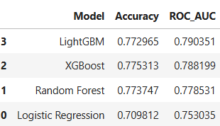

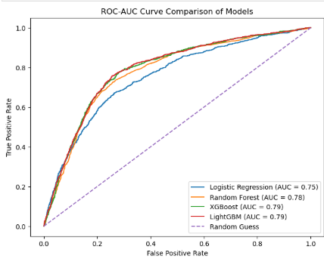
Accuracy
Experimental Results :
Understanding
LightGBM:
Target 0 (Stay): Precision = 85%, Recall = 85%, F1-score = 85%→ The model consistently and accurately identifies employees who are likely to stay.
Target 1 (Leave): Precision = 54%, Recall = 55%, F1-score = 55%→ The model captures more than half of the employees who leave, indicating meaningful learning of attrition patterns.
Overall Insight: LightGBM achieves the highest ROC–AUC score (79%), showing the strongest ability to distinguish between employees who stay and those who leave. Its stable performance across both classes makes it the most reliable mode
Precision: The accuracy of the model when it claims to have found something.
Recall: Recall: The ability of a model to find all the relevant cases
F1 Score: A balance between recall and precision, useful when both false positives and false negatives need to be minimized.
XGBoost:
Target 0 (Stay): Precision = 85%, Recall = 85%, F1-score = 85%→ The model performs strongly and consistently for employees who stay.
Target 1 (Leave): Precision = 55%, Recall = 56%, F1-score = 55%→ The model moderately identifies employees who leave, with performance close to LightGBM.
Overall Insight: XGBoost shows competitive results but slightly weaker overall discrimination compared to LightGBM, making it a strong but secondary choice

Slide 16
Random Forest Classifier:
Target 0 (Stay): Precision = 84%, Recall = 85%, F1-score = 85%→ The model effectively predicts employees who remain with the company.
Target 1 (Leave): Precision = 55%, Recall = 53%, F1-score = 54%→ The model identifies attrition cases with moderate success but misses more leaving employees than boosting-based models.
Overall Insight: Random Forest performs well for the majority class but shows slightly reduced effectiveness in identifying employee attrition.
Logistic Regression:
Target 0 (Stay): Precision = 87%, Recall = 72%, F1-score = 79%→ The model predicts employees who stay with high precision but lower recall.
Target 1 (Leave): Precision = 45%, Recall = 68%, F1-score = 54%→ The model captures many employees who leave but produces more false positives.
Overall Insight: Logistic Regression shows high sensitivity to employee attrition but lacks balance between precision and recall, resulting in weaker overall performance.
INFERRENCE:
LightGBM is selected as the final model because it achieves the highest ROC–AUC score and provides the most consistent and balanced performance across both target classes compared to XGBoost, Random Forest, and Logistic Regression
This model is used to make a final prediction on Test data

Slide 17



Conclusion
Conclusion
Key Findings
The final model was applied to Test data, predicting that 75.8% are likely to stay while 24.2% are at risk of leaving. Although most employees are expected to remain, the identified attrition group highlights a segment that requires targeted retention efforts to improve workforce stability.
City and City development index were identified as most influential features in predicting the target variable
Limitations
Moderate accuracy in predicting employees who leave; some attrition cases may be missed. Predictions are based only on available dataset features
The model may not generalize well to other organizations or future time periods, and does not capture changes in employee behavior over time.
The model provides probability-based predictions, so outputs should be used as guidance rather than absolute decisions.
Future research
Future research could focus on enhancing model performance by incorporating additional employee-related features or advanced modeling techniques to better predict attrition in similar datasets.

Slide 18


